Slide 1
Ram Prasad
Sales Dashboard Project in Tableau
I developed an interactive Sales Dashboard using Tableau to provide actionable insights into sales performance. The project aimed to empower decision-making for sales teams and executives by visualizing key metrics and trends.
Project Overview
Objective:
→ Develop a Sales Dashboard to provide actionable insights into sales performance.
Purpose:
→ Enable data-driven decision-making for sales teams and executives.
Key Features:
→ Interactive visualizations, complex calculations, and user-friendly design.

Slide 2
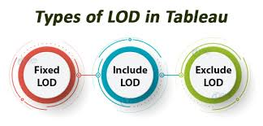
Data Handling
Data Source:
→ Imported sales data from Microsoft Excel.
Data Cleaning and Preprocessing:
→ Addressed missing values and ensured data consistency for accurate reporting.
Tools Used:
→ Microsoft Excel, Tableau.
Advanced Calculations
LOD Expressions:
Used Level of Detail (LOD) expressions for complex calculations.
Enabled detailed analysis at different data granularity levels without altering visual representation.

Slide 3
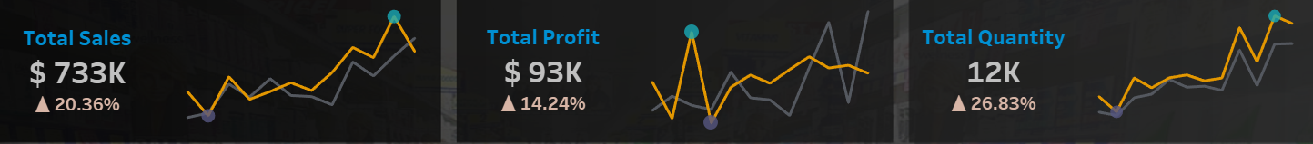
Visualizations
Sparklines:
→ Visualized trends over time, highlighting maximum and minimum values.
KPIs:
→ Developed KPIs to track key metrics like total sales, total profit, and total quantity.
Key Visuals:
→ Sparklines, KPI Cards, Graphs.

Slide 4
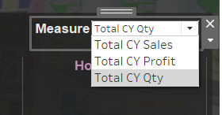

Interactivity and User Experience
Filters and Parameters:
Added interactive filters to allow users to explore data dynamically.
Integrated parameters to enable flexible, user-driven data interaction.
Navigation:
→ Implemented light and dark mode switcher for improved accessibility and user experience.

Slide 5
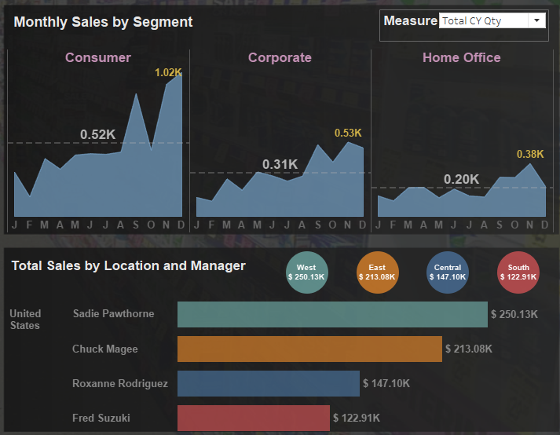
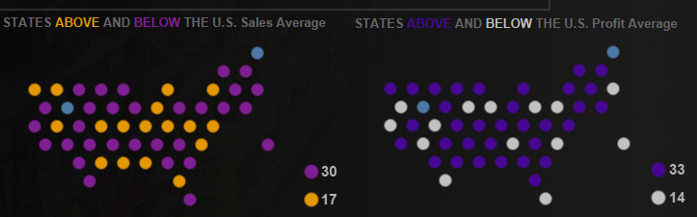
Business Insights
Key Insights:
Sales and profit distribution by state, highlighting above/below-average performance.
Monthly sales trends by segment, with performance evaluation by location and manager.
Impact:
→ Empowered stakeholders to make informed decisions and optimize sales strategies.

Slide 6
Conclusion
Summary:
→ Developed an interactive and dynamic sales dashboard that provides deep insights into sales performance.
→ Enhanced decision-making through advanced calculations, visualizations, and a user-centric design.
GitHub Link: https://github.com/ram0109/Sales-Dashboard-Tableau/tree/main
Thankyou!
Ram Prasad

Slide 7
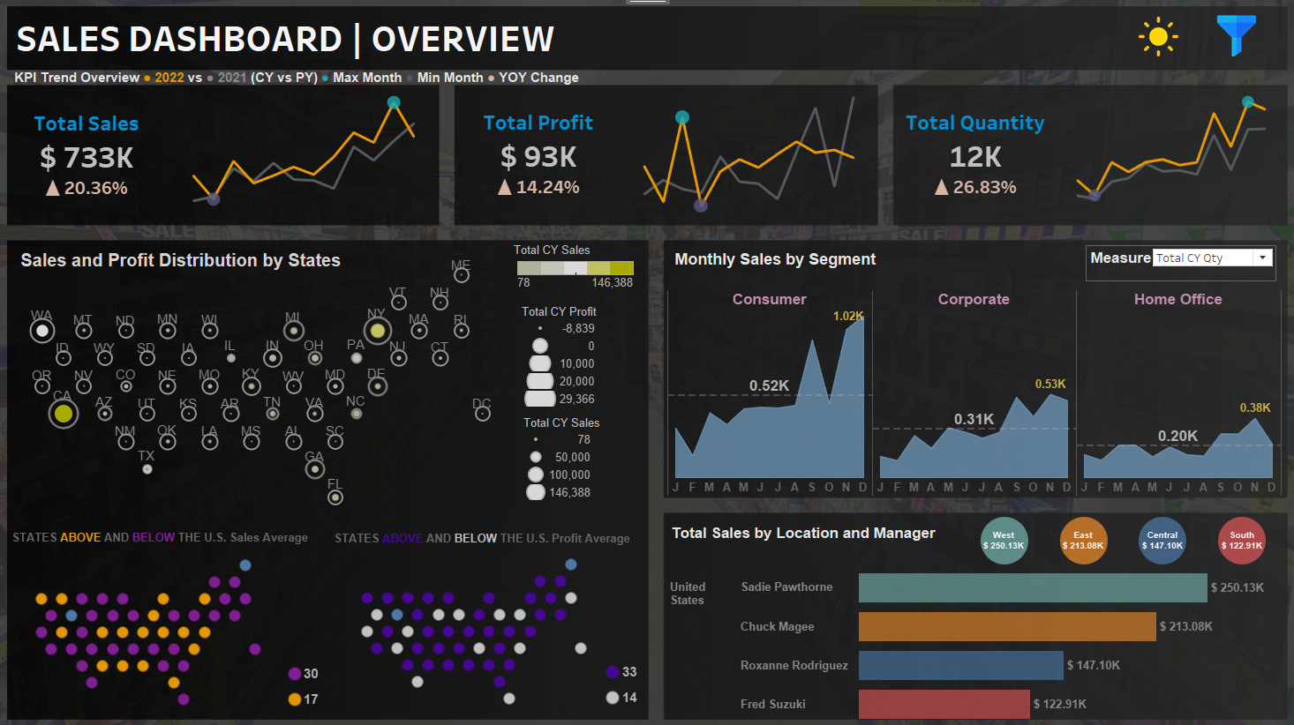

Slide 8
